Slide 1
Introduction to Java AND Maven
Jelena Vidović, Igor Kujacic, Strahinja Dobrijević, Dalibor Makan
Novi Sad, 2023

Slide 2
Agenda
01
02
Java
Maven
2

Slide 3

Java
3
Notes:
3

Slide 4
Which Version of JAVA do you Use ?
Java SE 6 (December 2006)
Java SE 7 (July 2011)
Java SE 8 (March 2014)
Java SE 9 (September 2017)
Java SE 10 (March 2018)
Java SE 11 (September 2018)
Java SE 12 (March 2019)
Java SE 13 (September 2019)
Java SE 14 (March 2020)
Java SE 15 (September 2020)
Java SE 16 (March 2021)
Java SE 17 (September 2021)
Java SE 18 (March 2022)
Java SE 19 (September 2022)
Java SE 20 (March 2023)
Java SE 21 (September 2023)
4

Slide 5
Which Version of JAVA do you Use ?
Java SE 6 (December 2006)
Java SE 7 (July 2011)
Java SE 8 LTS (March 2014)
Java SE 9 (September 2017)
Java SE 10 (March 2018)
Java SE 11 LTS (September 2018)
Java SE 12 (March 2019)
Java SE 13 (September 2019)
Java SE 14 (March 2020)
Java SE 15 (September 2020)
Java SE 16 (March 2021)
Java SE 17 LTS (September 2021)
Java SE 18 (March 2022)
Java SE 19 (September 2022)
Java SE 20 (March 2023)
Java SE 21 LTS (September 2023)
5

Slide 6
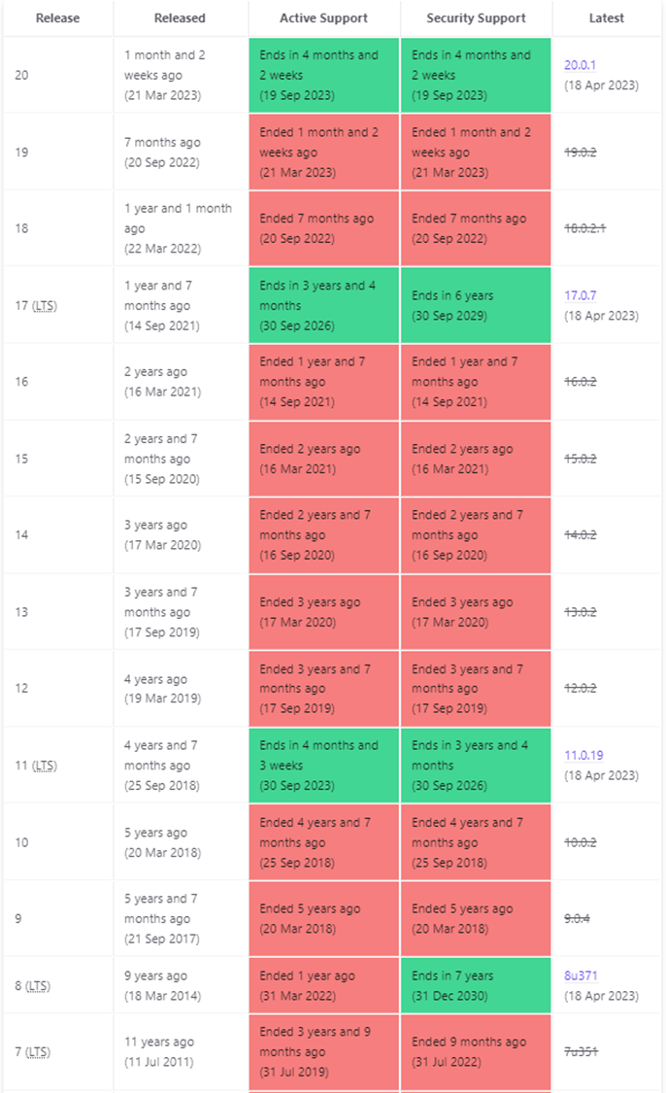
LTS (Long Term support)
None LTS versions get free public updates less than a year
LTS versions get free public updates for few more years
depending on the vendor
6

Slide 7
LTS (Long Term support)
What do we get with new updates
New features
Bug fixes
Security fixes
Exploiting security issues can have a big impact on the companies
Companies have written contracts where they state that they must receive security patches
7

Slide 8
When to Upgrade?
Complexity of upgrade depends on
How big is the impact of the changes (backward-compatible or not)
Are companies ready to invest in an upgrade at that moment or should developer be focused on business epics
Suggestion
Never use non-LTS version of Java for production code
Upgrade to next LTS version (Java 17 in our case) needs to be planned
8

Slide 9
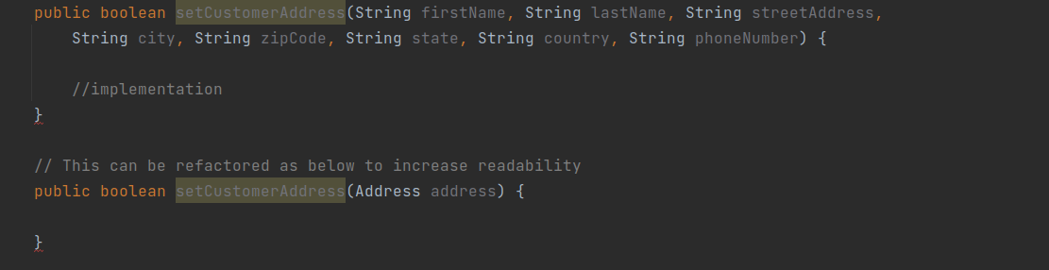
Clean code
What is it and why we should care about it ?
Project structure
Naming Convention (Classes, variables, methods)
Source File Structure (package, imports, variables, constructors, methods)*
Whitespaces and Indentation
Method parameters
9

Slide 10
Clean code
Hardcoding
Code comments
JavaDoc
Logging
Solid principles
Single Responsibility Principle
Benefits: easy testing, fewer dependencies, better organization
Open-Closed Principle
Open for Extension, Closed for Modification
Liskov Substitution Principle
Objects of a superclass should be replaceable with objects of its subclasses
without breaking the application
Interface Segregation Principle
Larger interfaces should be split into smaller (implementing classes should care about method of interest)
Dependency Inversion Principle
10

Slide 11
How to keep code clean and tools to help us
Setting up our work environment
Code formatters
Coding styles
Tools for code analysis
Best practices: (https://geosoft.no/javastyle.html)
Accessibility of classes and members should be minimized
Public methods must be properly documented (arguments and return values)
Utility classes (classes with static methods only) should have a private constructor
Checked exceptions must be properly handled
Methods that returns collection should never return null. Return an empty collection instead
Level of nesting should be kept as low as possible
Never use else after returning from an if-clause
Don't use if-else if the ternary operator can be used instead
11

Slide 12
Agenda Java
01
02
Java 8
Java 9
03
04
Java 10
Java 11
12

Slide 13
Java 8
13
Notes:
13

Slide 14
LAMBDA EXPRESSIONS – WHAT IS LAMBDA?
Lambda is equivalent to a method without a name
Also referred as anonymous function. Has everything that regular method has (method parameters, method body, return type)
Not tied to any class, like regular method
Can be assigned to a variable and passed around
Main purpose is to implement Functional Interface (interface that contains only one abstract method)
Embraces code reusability
14

Slide 15
LAMBDA EXPRESSIONS – SYNTAX
() -> {}
IMPORTANT:
We might show lambdas as () -> {} but in reality, you must always use it when a resulting type is defined or expected. For instance:
() -> {}; is not allowed as compiler has no idea what this is.
Runnable task = () -> {}; is allowed as compiler knows what lamda is supposed to implement.
Always keep in mind: At the end of the day, Java is still a strongly typed language. If type can't be implied, it must be declared.
Method parameters
Method body
15

Slide 16
LAMBDA EXPRESSIONS – SYNTAX
Basic example: () -> { System.out.println(“Hello World”);};
If method body is a single line statement, than curly braces are not needed
() -> System.out.println(“Hello World”);
For multiple statements, curly braces are mandatory
Parameter type is optional in lambda, compiler is smart enough to determine it’s type
BiConsumer<Integer> consumer = (Integer a,Integer b) -> a.compareTo(b); can be simplified to: BiConsumer<Integer> consumer = (a, b) -> a.compareTo(b);
Parenthesis are optional if lambda has one parameter
(n) -> n + 1 can be simplified to n -> n + 1
16

Slide 17
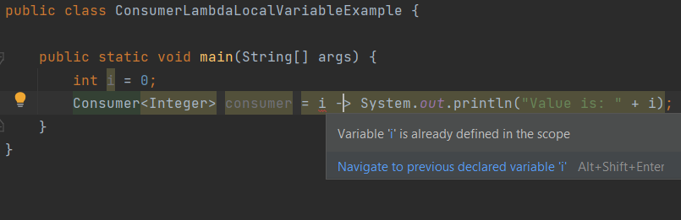
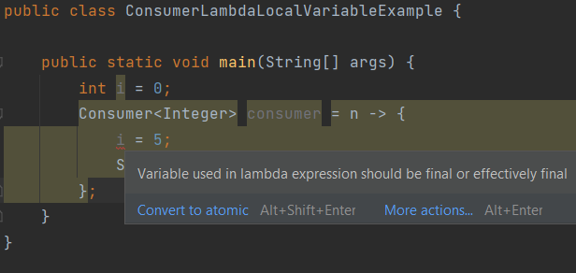
LAMBDA EXPRESSIONS – LOCAL VARIABLES
Any variable declared inside a method is called a local variable
Restrictions on using local variables:
Not allowed to use same local variable name as lambda parameter or inside lambda body
Not allowed to re-assign value to a local variable
17

Slide 18
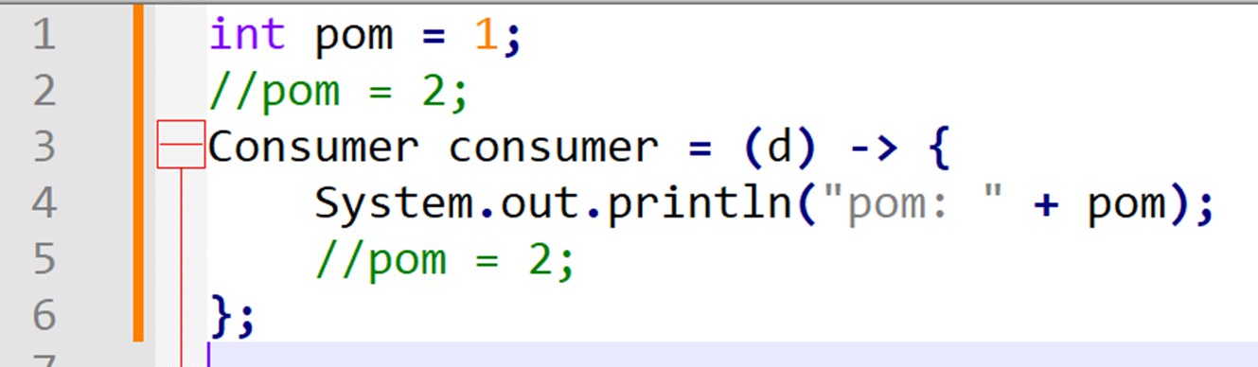
LAMBDA EXPRESSIONS – EFFECTIVELY FINAL
Lambda’s are allowed to use local variables but not allowed to modify them, even though they are not declared final. This concept is called effectively final
Prior to Java 8 any variable used inside anonymous class should be declared final
Advantages of effectively final:
Easy to perform concurrency operations
Promotes functional programming and demotes the imperative style of programming
18

Slide 19
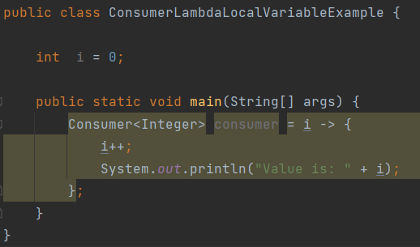
LAMBDA EXPRESSIONS – LOCAL VARIABLES
No restrictions on instance variables
19

Slide 20
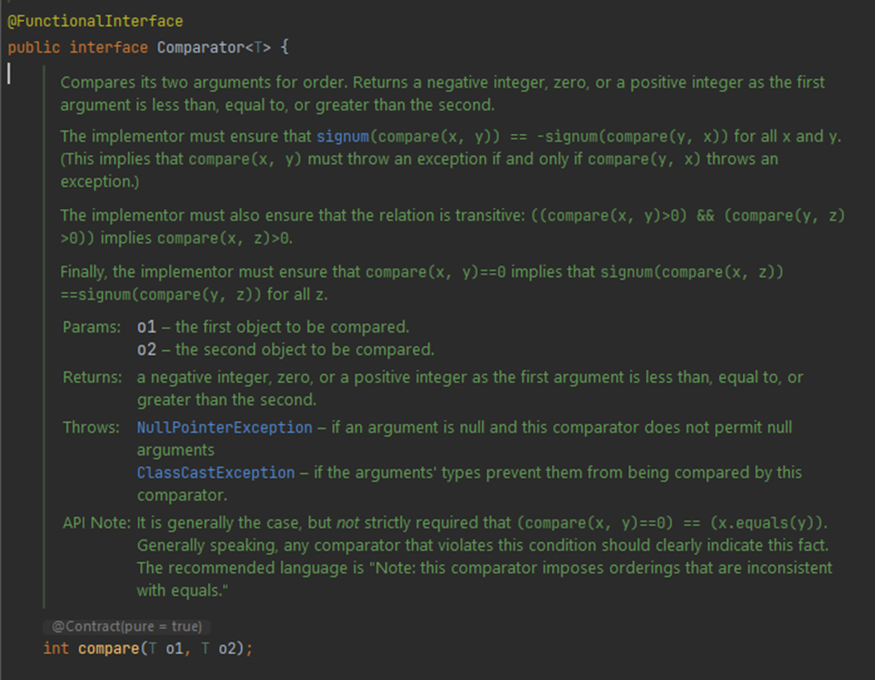
LAMBDA EXPRESSIONS
CompartorExample.java
20

Slide 21
FUNCTIONAL INTERFACE
Exists in Java since 1.0
Package: java.util.function
SAM -> Single Abstract Method
Functional Interface (SAM) is an interface that has exactly one abstract method
@FunctionalInterface – annotation introduced in Java 8
Optional annotation for validation that interface is functional interface and does not break contract, mandates interface to have only one abstract method
New functional interfaces introduced in Java 8: Consumer, Predicate, Function, Supplier
Each of these have their extensions such as BiConsumer, BiPredicate, BiFunction…
Functional Interfaces that existed before Java 8: Comparator, Producer
21

Slide 22
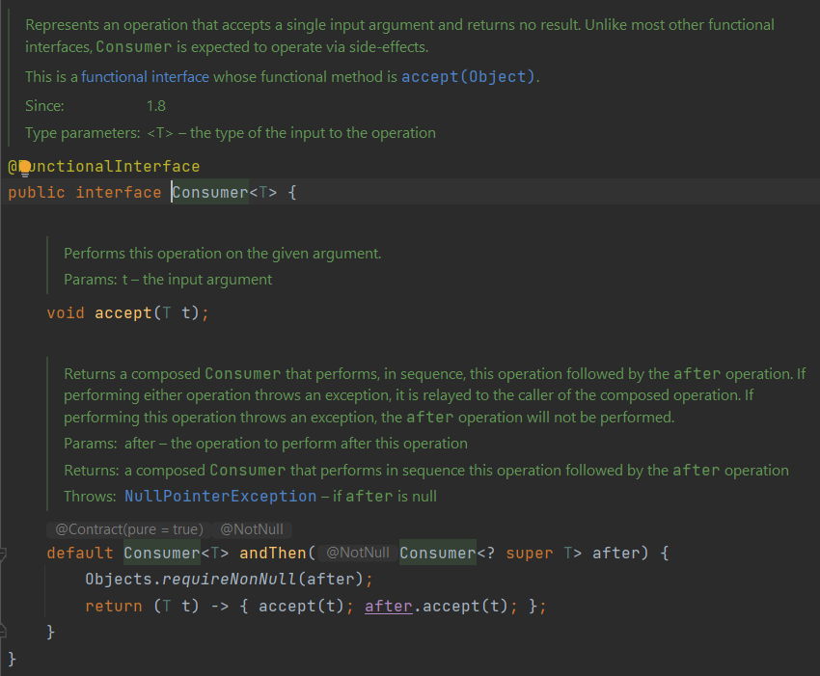
FUNCTIONAL INTERFACE - CONSUMER
22

Slide 23
FUNCTIONAL INTERFACE - CONSUMER
Abstract method void accept(T t) - accepts input and performs operation on that input
Default method andThen
Useful when performing operations on collections
ConsumerExample.java
23

Slide 24
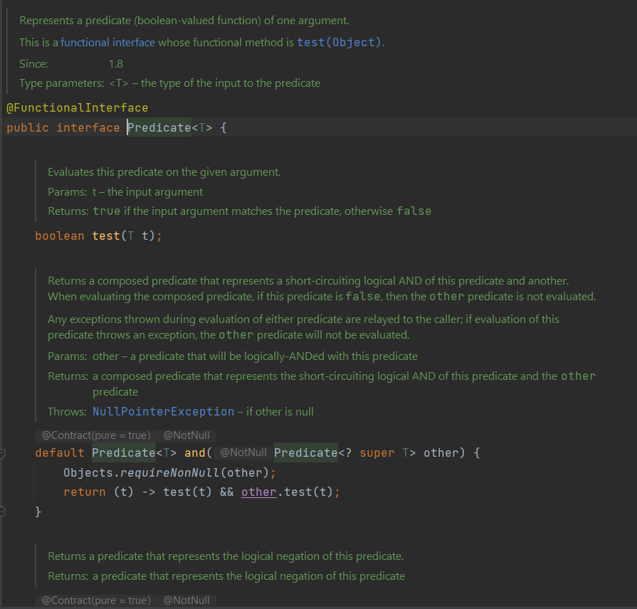
FUNCTIONAL INTERFACE - PREDICATE
24

Slide 25
FUNCTIONAL INTERFACE - PREDICATE
Abstract method boolean test(T t) - accepts input, perform operation on input and returns boolean
Default methods and, negate, or
Idea to use lambda to test condition
PredicateExample.java
25

Slide 26
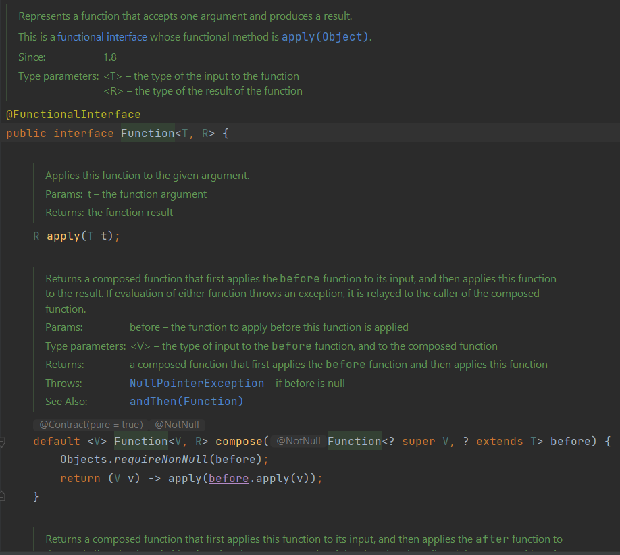
FUNCTIONAL INTERFACE - FUNCTION
26

Slide 27
FUNCTIONAL INTERFACE - FUNCTION
Using function interface we can implement a functionality and assign that functionality to a variable
Abstract method R apply(T t)
Two default methods compose and andThen
Useful when transforming a value or collection of values
FunctionExample.java
27

Slide 28
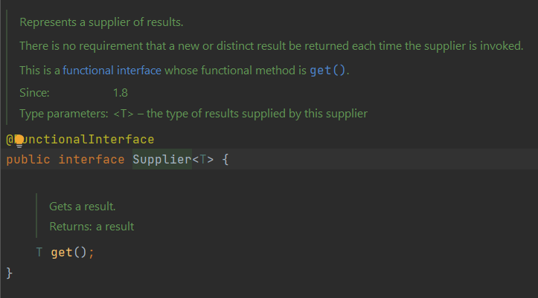
FUNCTIONAL INTERFACE - SUPPLIER
28

Slide 29
FUNCTIONAL INTERFACE - SUPPLIER
Has only one method T get()
Opposite to consumer functional interface, doesn’t take input and returns output
SupplierExample.java
29

Slide 30
METHOD REFERENCE
Introduced as part of Java 8 and its purpose is to simplify the implementation of Functional Interfaces
Simplify Lambda expression
Shortcut for writing lambda expressions
Refer a method in a class
Using method reference we can write simpler and more readable code
Code quality checkers like SonarQube prefer use of Method Reference
You can always write lambda expression, compiler won’t force you to use Method Reference
Syntax:
ClassName::instance-methodName
ClassName::static-methodName
Instance::methodName
30

Slide 31
METHOD REFERENCE – WHERE TO USE
Lambda expressions referring to a method directly
Example using Lambda: Function<String, String> toUpperCaseLambda = s -> s.toUpperCase();
Example using Method reference: Function<String, String> upperCaseMR = String::toUpperCase;
System.out::println (ComparatorExample.java)
Developer::getAge (ComparatorExample.java)
listDevs.sort(Comparator.comparingInt(Developer::getAge));
31

Slide 32
CONSTRUCTOR REFERENCE
Introduced in Java 8
Can only be used in context of functional interface
Syntax:
ClassName::new
Valid: Supplier<Country> countrySupplier = Country::new; (this creates supplier which is going to return new object)
Invalid: Country country = Country::new; -> compilation issue: Country is not functional interface
32

Slide 33
DEFAULT AND STATIC METHODS IN JAVA INTERFACES
Prior Java 8 interfaces were only allowed to declare a method and not allowed to implement method in interface. Implementation was only allowed in implementation class. So default and static methods were not allowed in interfaces prior java 8.
Multiple inheritance in classes is NOT allowed in java (InheritanceClasses.java)
Multiple inheritance in interfaces is allowed in java 8 (InheritanceInterfaces.java)
Default methods: default keyword to identify default method
Can be overridden by implementation class
Used to evolve the interfaces
Static methods: similar to default methods
Cannot be overridden by implementation class
33

Slide 34
Optional
boolean vs Boolean
The purpose of the class is to provide a type-level solution for representing optional values instead of null references.
Very useful when dealing with null values
Optional<String> opt = Optional.of(name); // NullPointerException
Optional<String> opt = Optional.ofNullable(name);
assertTrue(opt.isPresent());
assertFalse(opt.isEmpty());
Exercise:
Create class Faculty, with list of students. Each student has firstName, lastName, age, and course (Java, QA, NET, Mobile or DevOPS)
Students are assigned to the course randomly (use Supplier)
Sort and print students by age (ascending and descending)
Print those which attend “Java” or “QA” course
34

Slide 35
Stream API
Java 8 introduce Stream API as powerful tool
A stream represents a sequence of elements and supports different kind of operations to perform computations upon elements
Java 8 Stream has many operations which can be pipe-lined together to get desired result.
Source – Stream takes Collections, Arrays, or I/O resources as input source.
Streams do not change the original data structure.
Stream operations are either intermediate or terminal
Streams = Monads
In functional programming, a monad is a structure that represents computations defined as sequences of steps. A type with a monad structure defines what it means to chain operations, or nest functions of that type together.
35

Slide 36
Stream API
List<String> myList = Arrays.asList("a1", "a2", "b1", "c2", "c1"); myList .stream() .filter(s -> s.startsWith("c")) .map(String::toUpperCase) .sorted() .forEach(System.out::println); // C1 // C2
36

Slide 37
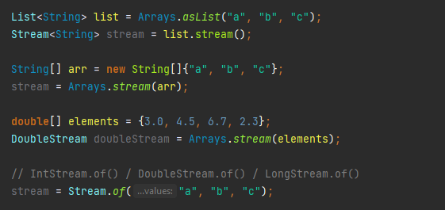
Stream API
In addition to Stream<T>, which is a stream of object references, there are primitive specializations for IntStream, LongStream and DoubleStream.
37

Slide 38
Intermediate vs Terminal operations
The main difference between intermediate and terminal operations is that intermediate operations return a stream as a result and terminal operations return non-stream values like primitive or object or collection or may not return anything
As intermediate operations return another stream as a result, they can be chained together to form a pipeline of operations. Terminal operations can not be chained together.
Pipeline of operations may contain any number of intermediate operations, but there has to be only one terminal operation, that too at the end of pipeline.
Intermediate operations are lazily loaded. When you call intermediate operations, they are actually not executed. They are just stored in the memory and executed when the terminal operation is called on the stream.
As the names suggest, intermediate operations doesn’t give end result. They just transform one stream to another stream. On the other hand, terminal operations give end result
Full list: https://docs.oracle.com/javase/8/docs/api/java/util/stream/Stream.html
38

Slide 39
Intermediate operations
filter(), map(), flatMap(), distinct(), sorted(), peek(), limit(), skip(), mapToInt(), mapToDouble(), …
Stream.of("Welcome", "To", "java", "java", "Code9") .distinct() .map(s -> s.equals("java") ? "Special" : s)
//[Welcome, To, Special, Code9]
List<String> list = Arrays.asList("1","2","13","4","15","6","17","8","19");
IntSummaryStatistics stats = list.stream().mapToInt(s -> Integer.valueOf(s)).summaryStatistics(); System.out.println("Highest number in List : " + stats.getMax()); // 19 System.out.println("Lowest number in List : " + stats.getMin()); // 1 System.out.println("Sum of all numbers : " + stats.getSum()); // 85 System.out.println("Average of all numbers : " + stats.getAverage()); // 9.44
39

Slide 40
Terminal operations
collect(), count(), forEach(), min(), max(), findFirst(), allMatch(), anyMatch(), noneMatch(), …
Stream.of("Mike", "Joseph", "John", "David", "Luke") .forEach(p -> { System.out.println("Name: " + p); });
//Name: Mike
//Name: Joseph
//Name: John
//Name: David
//Name: Luke
Person oldestPerson = personList.stream() .max(Comparator.comparing(Person::getAge)) .orElseThrow(NoSuchElementException::new);
40

Slide 41
SEQUENTIAL and parallel streams
Any stream operation in Java, unless explicitly specified as parallel, is processed sequentially. They are basically non-parallel streams used a single thread to process their pipeline.
The primary motivation behind using a parallel stream is to make stream processing a part of the parallel programming, even if the whole program may not be parallelized. Parallel stream leverage multicore processors, resulting in a substantial increase in performance, particularly for large data sets.
List<Integer> list = Arrays.asList(1, 2, 3, 4, 5, 6, 7, 8, 9); list.stream().forEach(System.out::print); System.out.println(); list.parallelStream().forEach(System.out::print);
//Sequential: 123456789
//Parallel: 657914823
41

Slide 42
Processing order
Stream.of("d2", "a2", "b1", "b3", "c") .map(s -> { System.out.println("map: " + s); return s.toUpperCase(); }) .filter(s -> { System.out.println("filter: " + s); return s.startsWith("A"); }) .forEach(s -> System.out.println("forEach: " + s)); // map: d2 // filter: D2 // map: a2 // filter: A2 // forEach: A2
// map: b1 // filter: B1
// map: b3 // filter: B3
// map: c // filter: C
42

Slide 43
collectors
Collect is an extremely useful terminal operation to transform the elements of the stream into a different kind of result, e.g. a List, Set or Map.
Collect accepts a Collector class
Java 8 supports various built-in collectors via the Collectors class. So for the most common operations you don't have to implement a collector yourself.
Commonly used Collectors:
groupingBy()
toSet()
toList()
toMap()
toCollection()
joining()
43

Slide 44
collectors
Map<Integer, String> users = Map. of(18, "David", 22, "Tom", 33, "John", 21, "Michael", 25, "Michael", 43, "Sasha"); users.entrySet().stream() .collect(Collectors.groupingBy(Map.Entry::getValue)) .forEach((p,x) -> System.out.println(x));
//[43=Sasha]
//[22=Tom]
//[25=Michael, 21=Michael]
//[33=John]
//[18=David]
44

Slide 45
collectors
List<String> users = List.of("David", "Tom", "John","Michael","Michael","Sasha"); users.stream() .collect(Collectors.toSet()) .forEach(p -> System.out.print(p + ” "));
//Sasha Tom Michael David John
List<String> givenList = Arrays.asList("a", "bb", "ccc", "dd");
givenList.stream()
.collect(Collectors.joining());
// "abbcccdd"
45

Slide 46
MAP VS FLATMAP
The map() method wraps the underlying sequence in a Stream instance, whereas the flatMap() method allows avoiding nested Stream<Stream<R>> structure.
The flatMap() method first flattens the input Stream of Streams to a Stream of Strings
Map() is used to transform each element in a stream into a new element, while flatMap() is used to transform each element in a stream into a new stream of elements, which are then combined into a single stream.
Stream.of("a", "b")
.map(String::toUpperCase)
.collect(Collectors.toList());
// A, B
List<List<String>> list = List.of( List.of("A"), List.of("B") );
list.stream() .flatMap(Collection::stream) .collect(Collectors.toList())
// A, B
46

Slide 47
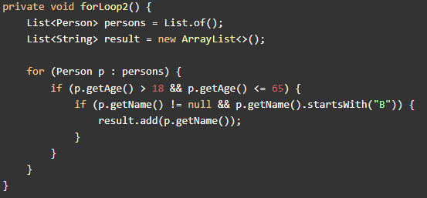
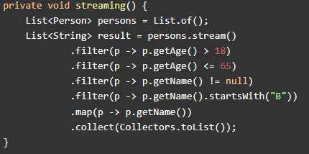
Streams vs for loop
If you have a small list, for loop performs better
If you have a huge list, a parallel stream will perform better
"Performant code usually is not very readable, and readable code usually is not very performant."
As the cost of maintenance is much higher these days than the cost of hardware, the trade-off usually leans towards readable/maintainable code now. So unless millisecond performance is mission critical, it is not a strong argument in most cases.
47

Slide 48
Java 9
48
Notes:
48

Slide 49
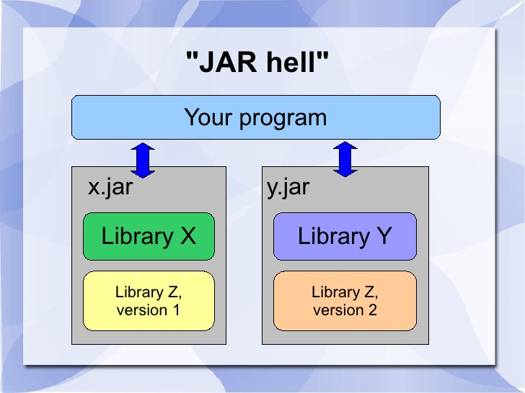
Problem with JDK
Multiple libraries referencing each other with no structural way, different versions involved …
You can easily run into JAR hell
Multiple versions of the JARs lying on the classpath, resulted in the ClassLoader loading the first found class from the JAR
ClassNotFoundException at runtime
How to resolve JAR hell?
49

Slide 50
Project JIGSAW
Introduce modularization
Unit of modularization is jar file and it represents a module
Refactoring JDK
Determine which api are critical and need to be implemented inside of jdk
Determine which api are non-critical and can be implemented outside of jdk (jaxb for example)
Determine which api are not needed and can be deprecated or deleted
JDK 9 consists of modules that are placed on module path
Module is created by adding module-info.java (which is not a typical java file) to the route of the project
Main motive for modules is encapsulation, plain and simple. More on this in few slides
50

Slide 51
MODULES
Module is a grouping of code in Java this is a collection of packages
The module can also contain native code, resources and configuration data
Module declaration:
module com.levi9.code9 {}
module-info.java must contain this file and it doesn’t interact with other java classes
Module dependencies module com.levi9.code9 { requires com.levi9.other
requires java.sql}
Our module is dependent on com.levi9.other and java.sql module
com.levi9.code9
com.levi9.other
java.sql
51

Slide 52
MODULE DEPENDENCY GRAPH
com.levi9.code9
explicit
com.levi9.other
java.sql
implicit
java.base
All modules depend on java.base module
52

Slide 53
ENCAPSULATION – WHAT and why?
Encapsulation is a way to control what our code uses, imports and, most important, what part of our code is visible when using our code as a dependency
Well, what's the word private for? Private members are still visible via reflection. Encapsulation addresses this issue. Using keyword "opens" allows our private members to be seen via reflection like before.
We can control which packages can use our code which is much appreciated feature by owners of proprietary libraries
We can also loosely couple our abstract classes and interfaces with their implementations (that are present in completely different modules). Just the fact that the module is present in our classpath is enough to provide our interface with a default implementation.
We can also use the awesome feature called "layers"
53

Slide 54
layers
Imagine the problem: Your code has two dependencies, and both use a library X as a dependency as well. Way of working to this day on most projects is to put the latest version of X in your classpath and hope there are no new bugs or breaking changes
Layers to the rescue (yaaaaay). Layers are like mini spaces in your memory that have their own classpath and use their own class loader.
As long as you don't export your dependency on X in any of your modules, you don't have to worry about JAR hell
Sadly, this is very difficult to achieve when using Maven as your dependency management as it puts all your dependencies into same classpath (therefore using the same class loader for all classes) and just uses the higher version in the conflict (unless specified otherwise by a developer)
Maven is still most widely used build tool and we will speak more of it later.
54

Slide 55
Java 10
55
Notes:
55

Slide 56
What’s new in Java 10
Local Variable Type Inference
Usage of var as local variable
Some features related to work with unmodifiable collections
copyOf()
toUnmodifiable()
Optional modification
Optional.orElseThrow()
Performance improvements
Garbage collector
Experimental Java base JIT compiler
Container awareness
JVMs are now aware of being run in a Docker container
56

Slide 57
LOCAL VARIABLE TYPE INFERENCE
One of the most visible enhancements in JDK 10 is type inference of local variables with initializers
Note that this feature is available only for local variables with the initializer
It cannot be used for member variables, method parameters, return types, etc
var is not a keyword. It is reserved type name just like int
Examples:
String message = “Goodbye Java 9”; //old way
var message = “Hello, Java 10”;
We don’t provide the data type of message. Instead we mark the message as var and the compiler infers the type of message from the type of initializer on right side.
Illegal use of var:
var n; //error: cannot use ‘var’ on variable without initializer
var emptyList = null; //error: variable initializer is null
public var something = “Hello” //error: ‘var’ is not allowed here
57

Slide 58
LOCAL VARIABLE TYPE INFERENCE
There are situations where var can be used legally, but may not be a good idea to do so.
Code could become less readable
Example: var result = obj.process();
It is difficult to understand return type of process method without entering method and checking it’s return type
58

Slide 59
UNMODIFIABLE COLLECTIONS
copyOf(Collection) new static method which returns unmodifiable copy of the given collection
Any attempt to modify such a collection would result in java.lang.UnsupportedOperationException runtime exception
List<Integer> copyList = List.copyOf(someList); copyList.add(9); //this will throw exception
toUnmodifiable() method to collect stream into unmodifiable list, map or set
Any attempt to modify such a collection would result in java.lang.UnsupportedOperationException runtime exception
List<Integer> list = someList.stream().filter(i -> i%2 == 0).collect(Collectors.toUnmodifiableList());
59

Slide 60
OpTIONAL ORELSETHROW
New method which doesn’t take any argument and throws NoSuchElementException if no value is present
It’s synonymus with and now preferred alternative to existing get() method
old way:
Optional<Student> optionalStudent = studentRepository.findById(id);
if(optionalStudent.isPresent()){var student = optionalStudent.get();}
new way:
var student = studentRepository.findById(id).orElseThrow();
We can add lambda expression and override thrown exception.
var student = studentRepository.findById(id).orElseThrow(() -> new NotFoundException(“Can’t find student”));
60

Slide 61
Java 11
61
Notes:
61

Slide 62
What’s new in Java 11
LTS support (every 3 years new LTS version)
Oracle doesn’t support commercial LTS versions without the license anymore(it is not free)
OpenJDK provides Java 11 JDK and it is free to use for commercial projects
OpenJDK releases are every 6 months and support is until the next release
OpenJDK is developed by Oracle, OpenJDK, Java community
New methods in String class:
boolean isBlank(length 0 and no whitspaces), “ ”.isBlank() //true “ ”.isEmpty() //false
lines(better performance than split)
strip, stripLeading, stripTrailing,(better performance than trim)
repeat(int n)(repeat string n times)
Files new methods
readString and writeString
New HttpClient - supports both HTTP/1.1 and HTTP/2, better overall performance than previous HttpURLConnection API
62

Slide 63
Java 11-JAVA 18
63
Notes:
63

Slide 64
RECORDS
Introduced to reduce repetitive boilerplate code in data model POJOs
They simplify day to day development, improve efficiency and greatly minimize the risk of human error
record keyword
While IDE can automatically generate many of these classes, they fail to automatically update our classes when we add a new field
Record declaration will automatically add a constructor, getters, equals, hashCode and toString methods
Example: public record User(int id, String password) {}
64

Slide 65
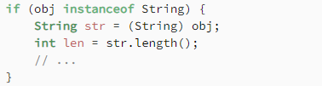

Pattern matching
Pattern matching, in general, was first introduced as a preview feature in Java SE 14.
Example:
Applying type patterns to the instanceof operator simplifies type checking and casting
65

Slide 66
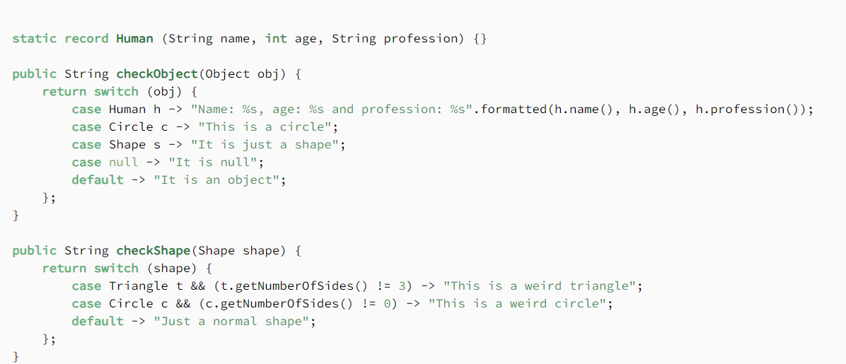
Pattern matching for switch
Improves expressiveness of the language
Example:
66

Slide 67

Maven
67

Slide 68
MAVEN
Maven is a powerful project management tool that is based on POM (project object model) file
It is used for projects build, dependency and documentation
In short terms maven is a tool that can be used for building and managing any Java-based project
Maven does a lot of helpful task like:
build a project
add jars and other dependencies
upgrade dependencies easily
provides project information (documentation, versioning, reports...)
can build any number of projects into output types like the JAR, WAR etc without doing any scripting
68

Slide 69
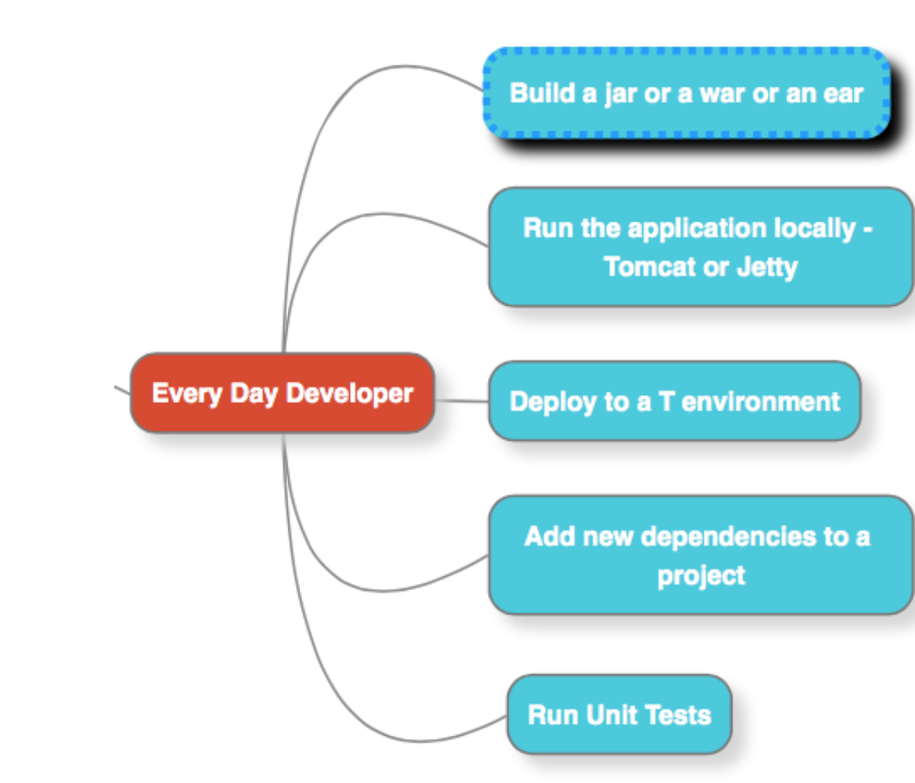
MAVEN
69

Slide 70
MAVEN – HOW TO BUILD A JAR
Imagine we want to build maven-project.jar which has App.java source class and AppTest.java
Steps needed:
App.java compile to App.class
AppTest.java compile to AppTest.class
Run the tests
Create Jar file
70

Slide 71
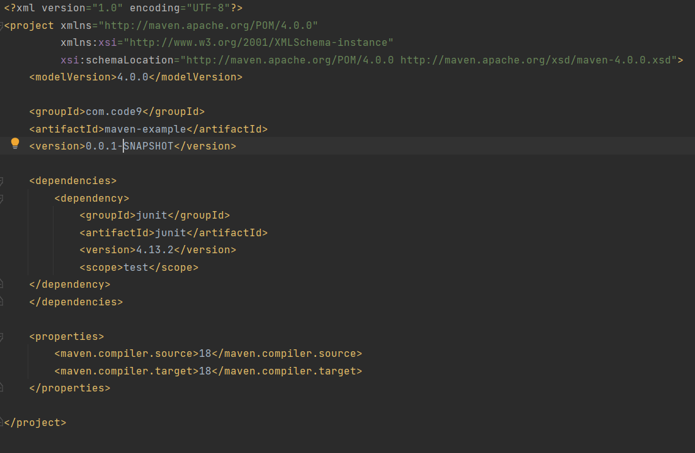
groupId, artifactId and version uniquely identify the project
groupId – unique package name
artifactId – project name
version – MAJOR.MINOR.PATCH format SNAPSHOT indicates this is development version
<dependencies> block is where we list dependencies needed for the project
With dependencies we say that project is dependent on those JARs to work properly
We can find dependencies on mvnrepository.com
When we add new dependency, jars are downloaded from the internet and stored into local repository
<properties> block is where we can define properties
They are value placeholders
Accessible anywhere within a POM using ${x} where x is property
Types of properties:
environment - ${env.x}
project - ${project.x}
settings - ${settings.x}
Java System Properties - ${java.home}
user defined - ${x}
where x is property
POM.XML STRUCTURE
71

Slide 72
TRANSITIVE DEPENDENCIES
Dependencies of dependency in our POM
With transitive dependencies conflicts can occur
You can use the mvn dependency:tree command to see the dependency tree and identify any conflicts
With transitive dependencies dependency graph can grow quite large, that is why there are additional features to limit which dependencies are included:
Dependency mediation
Dependency management
Dependency scope
Excluded dependencies
Optional dependencies
72

Slide 73
Dependency mediation
Dependency mediation is the process by which maven resolves conflicts between different versions of the same dependency that are included in the project's dependencies
When there are multiple versions of the same dependency included in a project's dependencies, maven uses a set of rules to determine which version of the dependency should be used:
The version of the dependency that is declared directly in the project's POM file takes precedence over any other version
If there are multiple versions of the dependency in the project's transitive dependencies, maven selects the version with the highest version number
If there are multiple versions of the dependency with the same version number, maven selects the first version that it encounters while traversing the dependency tree
73

Slide 74
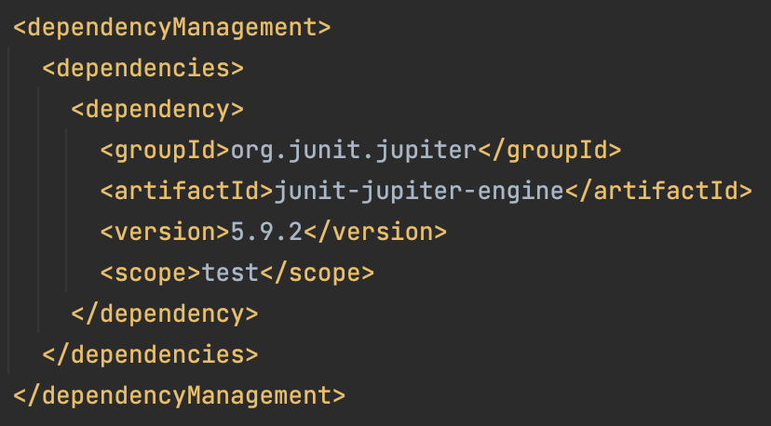
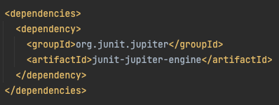
Dependency management
<dependencyManagement> is a section in the maven POM file that is used to manage dependency versions for a project and its sub-modules
Provides a way to resolve these conflicts by centralizing the version management of a dependency in a single location
You can define a particular version of a dependency in the <dependencyManagement> section and then refer to that version in the <dependencies> section of your module's or sub-module's POM file, instead of specifying the version of the library in each module's POM
74

Slide 75
DEPENDENCY SCOPE
Used to determine when a dependency is included in a classpath
To define scope use <scope> block
For example, JUnit is used only in tests, and we don’t need that dependency when we compile or run our source code, but we want that to be used when compiling test classes, in that case we will use test scope
Most common scope types:
compile – default scope, used for dependencies that are required for compiling, testing, and running the application
runtime – The dependencies with this scope are required at runtime, but we don’t need them for compiling or testing the code, for example JDBC dependency
test – JUnit example mentioned above
provided – is used for these dependencies that should not be included in the final artifact, as they are expected to be provided by the container or environment where the application will run, for example application server (Tomcat) is responsible for providing it
75

Slide 76
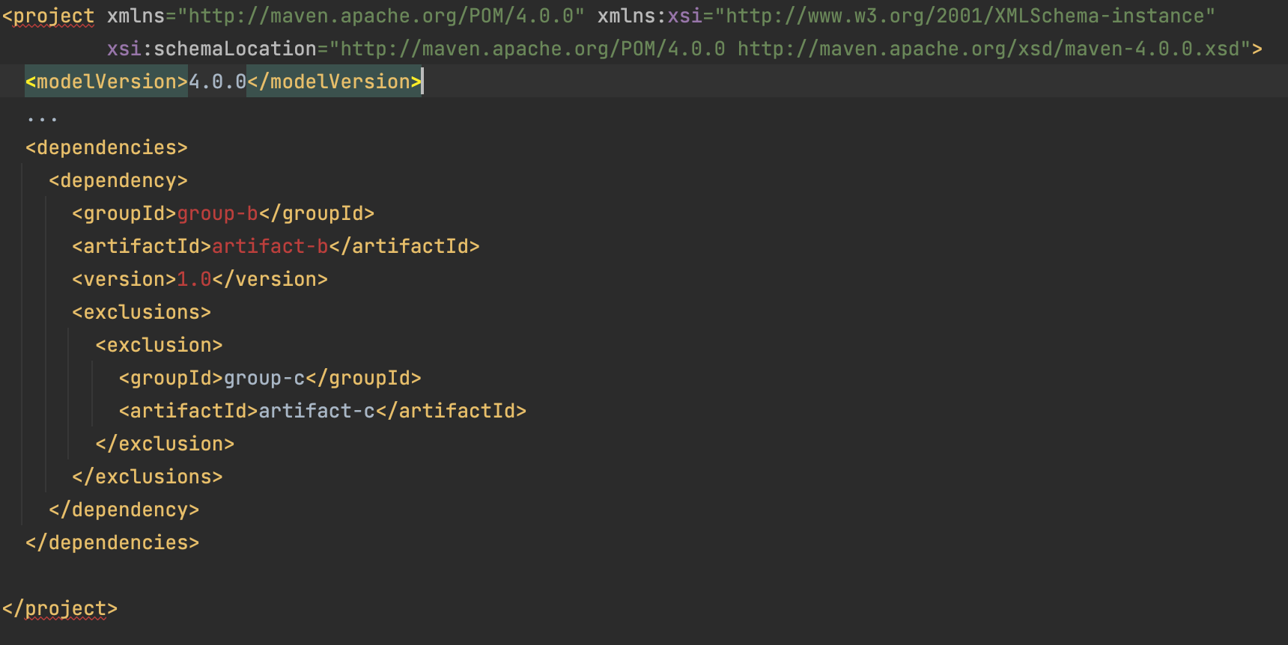
Excluded dependencies
We can exclude unwanted dependencies
For example: project A depends on project B, and B depends on project C, since maven resolves dependencies transitively C will be included in A classpath
If for any reason, we don't want dependency C to be present in A classpath, that can be achieved using <exclusions> block
76

Slide 77
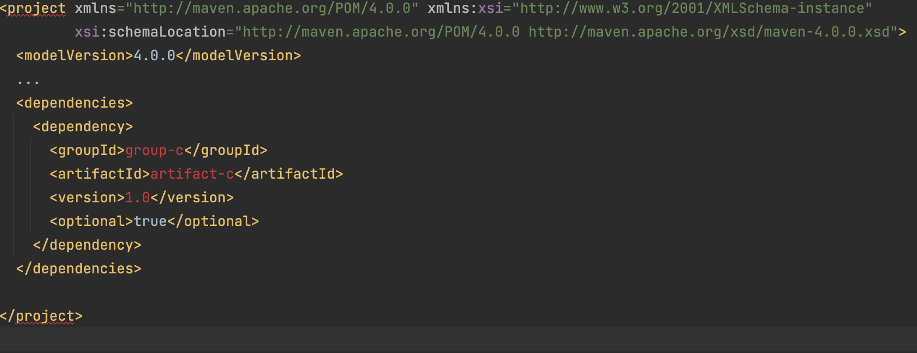
Optional dependencies
Some of the dependencies are only used for certain features in the project and those will not be needed if that feature is not used, so no need for them to be included into classpath
For example: project B depends on project C and C is marked as optional, that means that if project A depends on B, dependency C will not be included in classpath of project A
If C is indeed needed in A, it can be added directly as a dependency
To mark some dependency as optional use <optional>
77

Slide 78
DEPENDENCY versioning
Maven allows you to specify the range of version that are acceptable to use
Range | Meaning
(,1.0] | v <= 1.0
1.0 | 1.0 or later version, if 1.0 is not available
[1.0] | Exactly 1.0
[1.2,1.3] | 1.2 <= v <= 1.3
[1.0,2.0) | 1.0 <= v < 2.0
[1.5,) | v >= 1.5
(,1.0],[1.2,) | v <=1.0 or v >= 1.2
(,1.1)(1.1,) | Excludes version 1.1
78

Slide 79
Maven SUPER, simplest and EFFECTIVE POM
Super POM is POM file which defines all default configurations (path to source/test source directory, resource directory, plugins...), and it is the parent POM for any other POM file
Simplest POM is the one you define for your maven project – it should at least contain groupId, artifactId and version
Effective POM combines default configuration from super POM with the configuration defined in application POM (simplest POM) – if some values are not overridden in application POM, maven uses the default ones from super POM
To get effective POM use command mvn help:effective-pom
Command for getting the settings that maven uses to run the build is mvn help:effective-settings
Most important configuration in the effective settings is the local repository
Local repository serves as a cache, if we have dependency already downloaded then we don’t need to go to central repository to download
79

Slide 80
Maven PLUGINS and goals
Maven is a plugin execution framework where every task is done by plugins
To use plugin in maven you need to specify it in POM file (and customize its behavior)
Maven goals are specific tasks that plugin can perform
Some of the commonly used maven plugins and its goals:
maven-clean-plugin – clean goal – cleans up target after the build
maven-compiler-plugin – compile goal – compiles Java source files
maven-surefire-plugin – test goal – runs JUnit unit tests and creates report
maven-install-plugin – install goal – installs the built artifacts into the local repository
Goals can be executed using mvn command followed by the goal name (mvn install)
Goals can be combined by specifying them in a single command separated by space
For example, if we want to clear up target of previous build and build new changes, we can use command mvn clean install
80

Slide 81
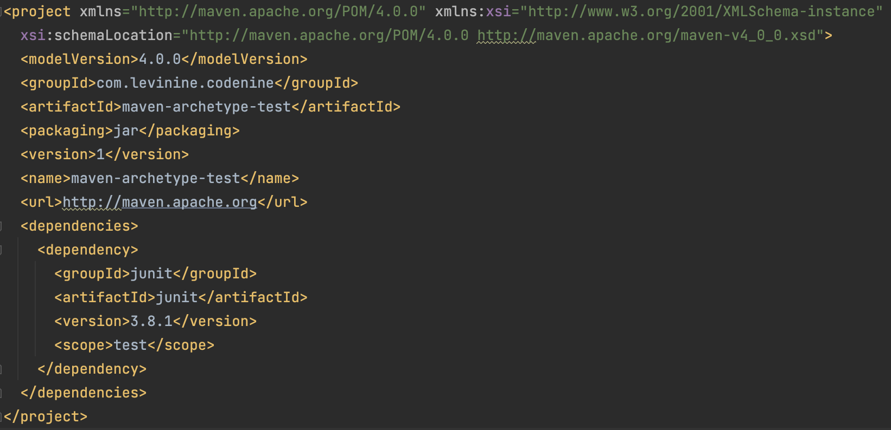
Maven ARCHETYPE
Maven archetype is project templating toolkit that generates new Maven projects
Helps users to quickly start a new Java project
mvn archetype:generate -DarchetypeArtifactId=maven-archetype-quickstart – this command will create a simple Java project with just JUnit added as a dependency
81

Slide 82
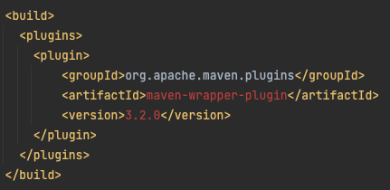
Maven WRAPPER
Maven wrapper is useful for projects that needs specific version of maven or for users that don’t want to install maven on their local machine. We just use project specific wrapper script
Wrapper should work with different operating systems
To use maven wrapper for your project you need to add maven wrapper plugin to your POM file and run command mvn wrapper:wrapper to generate the wrapper files
After that we can run goals ./mvnw clean install (instead of a regular mvn clean install)
The important thing here is that if user doesn't have necessary version of maven installed, it will be downloaded and installed first, and then used
82

Slide 83
ANY QUESTION ?
83

